Slide 1

Engineering Process Change for Control Tower
(Updated as on 18-12-2018)

Slide 2
Purpose
Following functionalities have been added/modified in ERP LN for Control Tower
  Post Order Technical Vetting
  Assign Sub Item to BOM
  Update Manual Outlook in Project
  Update PMDL Schedules from Control Tower

Slide 3
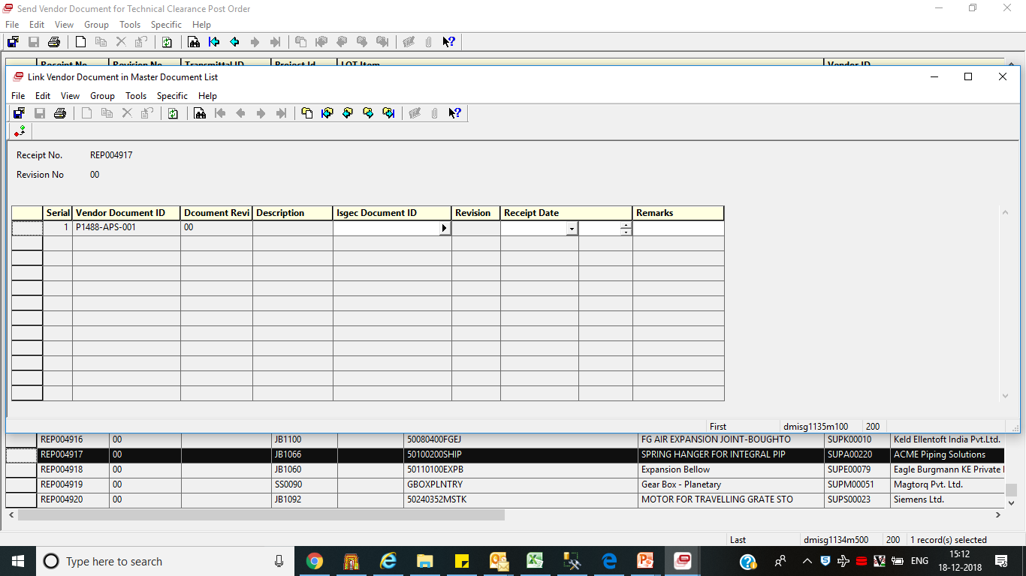
  Modified - Post Order Technical Vetting
Old Functionality - VEN document is linked with Post order receipt after evaluation of document and after release of VEN document in PLM.
New Functionality - VEN document linking has to be done with Post order receipt immediately after receiving it from Materials/Vendor. Now it can be linked before approval of VEN document in PLM also.

Slide 4
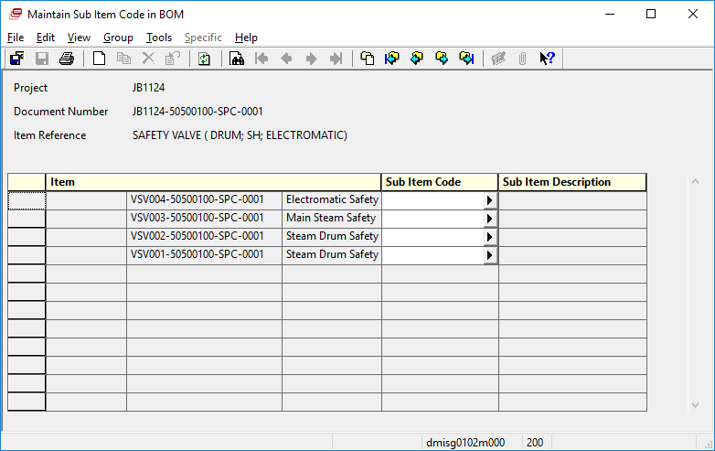
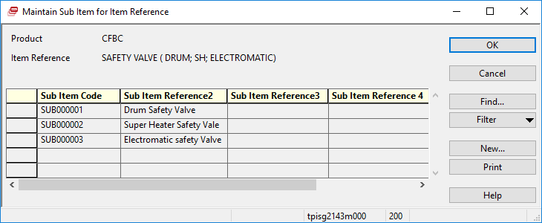
  New - Assign Sub Item to BOM
If Item reference of Drawing has sub items then it is mandatory to assign sub item against Engineering Item before approval of Drawing in PLM.
Zoom is given for applicable Item reference in session

Slide 5
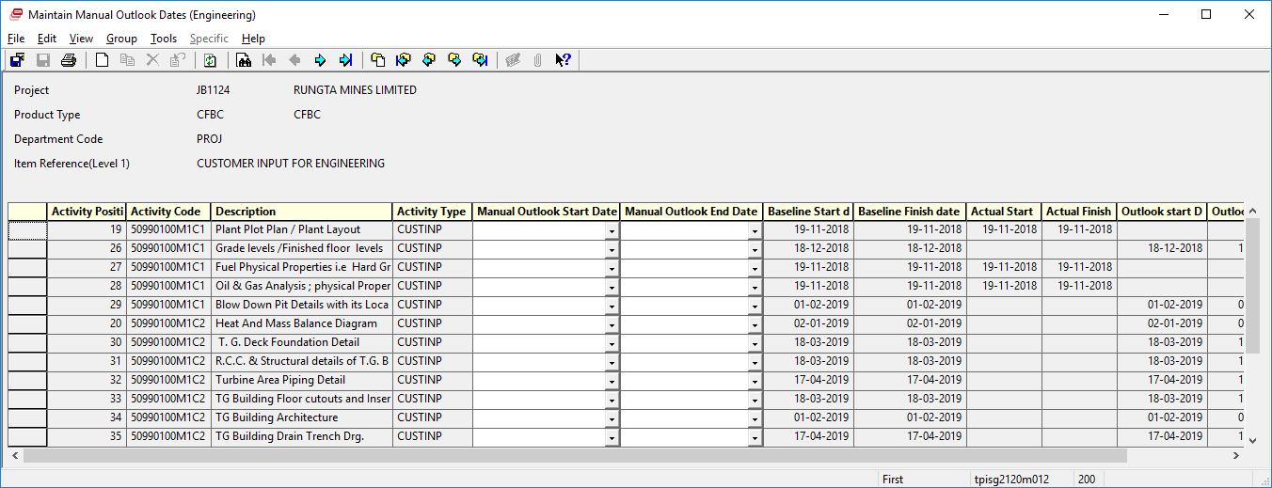
  New - Maintain Manual Outlook Dates if Engineering Outlook dates are different than system generated outlook dates
User has to input Manual Outlook Start and End Dates in above session

Slide 6
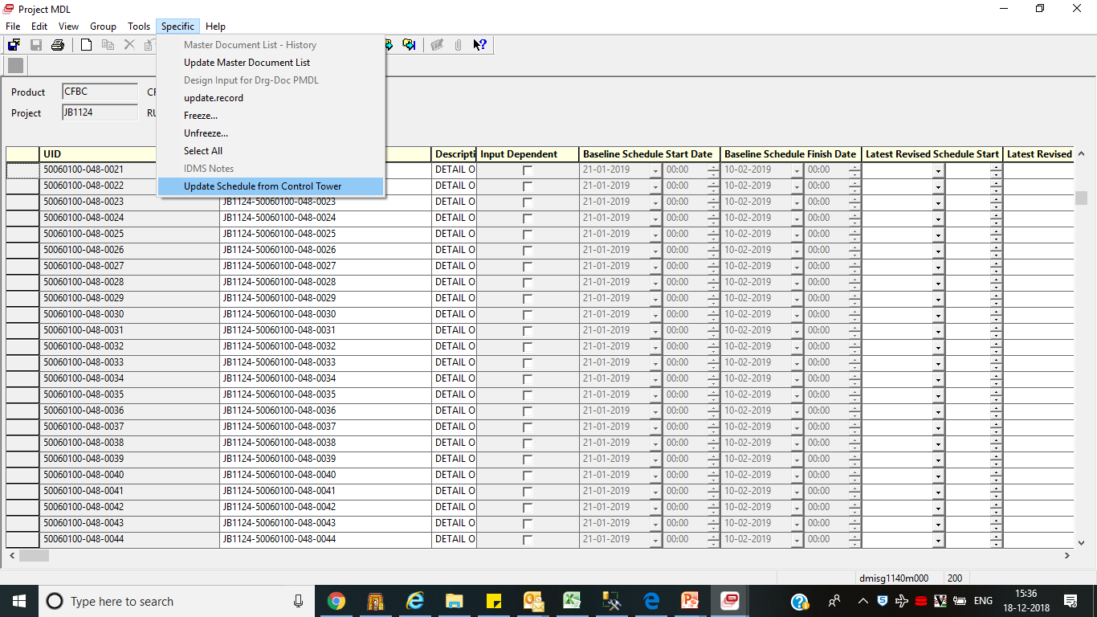
  New-Update Schedule for Control Tower
Use above option to update PMDL Baseline schedule Start and end dates from Control Tower Baseline Start and Finish Dates in addition to this PMDL Revised Schedule Start and Finish Dates will be updated from Control Tower Manual Outlook Start and Finish Dates

Slide 7
End of Document

